Slide 1
UIU Eatery -Cafeteria Management System-

Slide 2
Taiyaba Taskin ID: 011162063
Shifa Chowdhury Iwase ID: 011183003
Md. Jubayer Hossain Sheebly ID:011183017
Md Tarifuzzaman ID: 011191245
Md Sazzad Mazumder ID: 011201285
Our Team

Slide 3
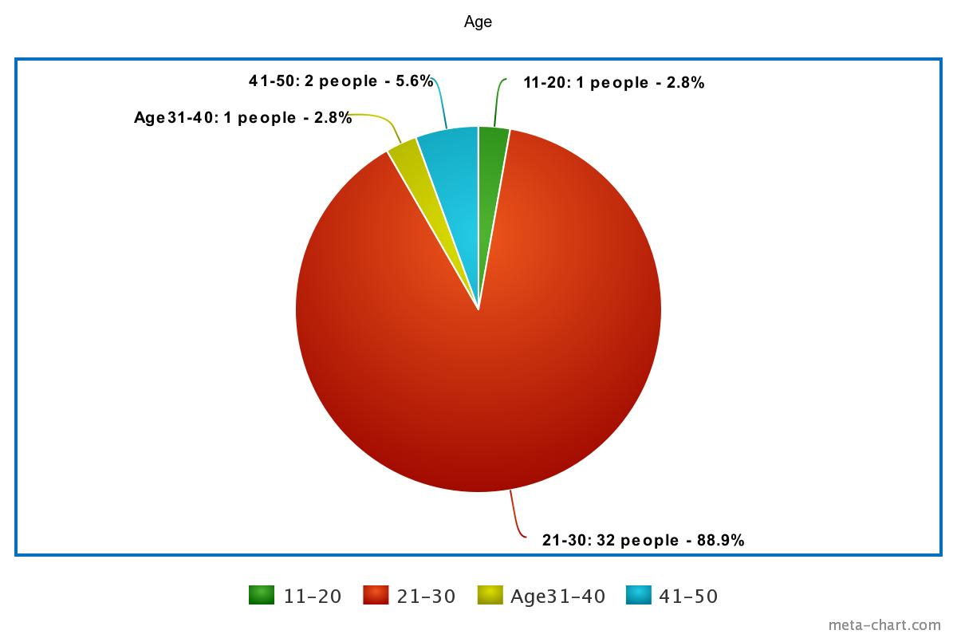
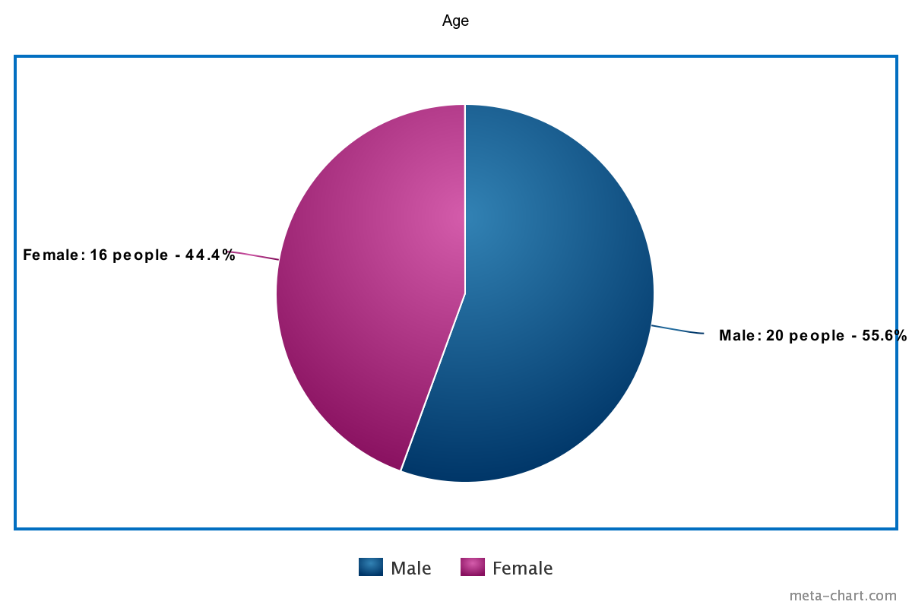
Survey audience
Total Survey Attendee: 36
89.9% attendee is 21-30 years old 55.6 % Male ; 44.4% Female

Slide 4
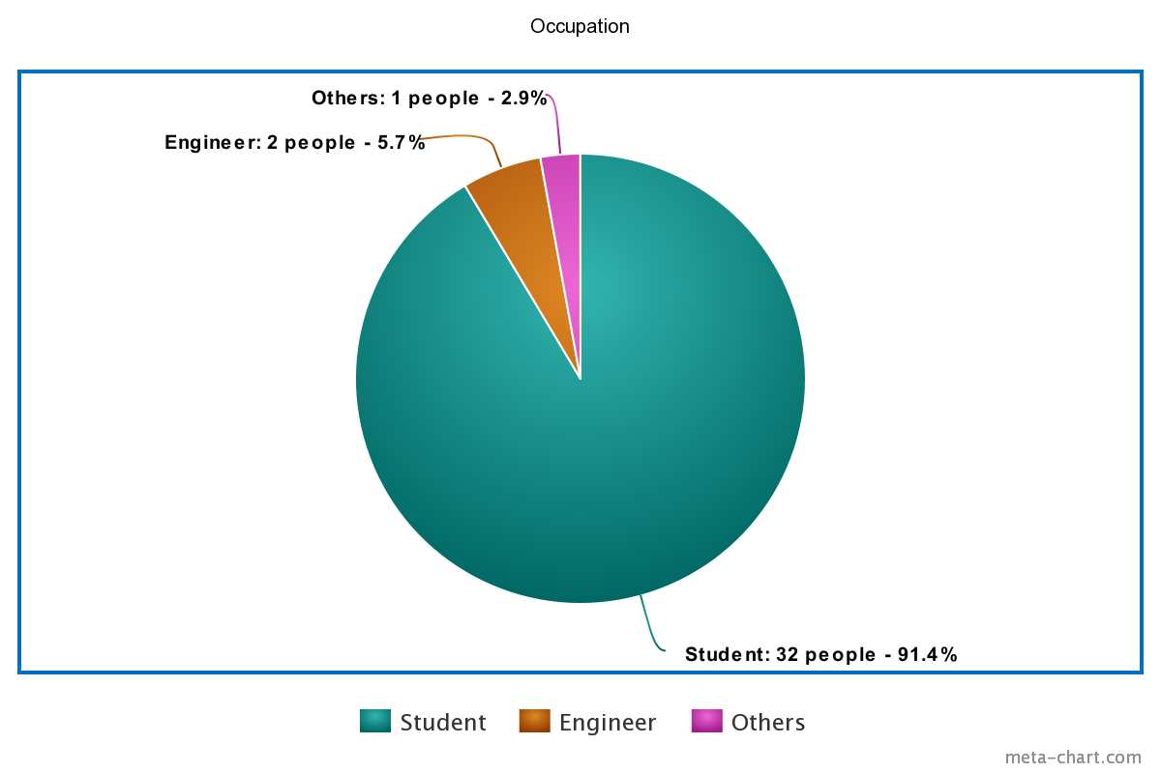

Survey audience
Information we collected from
91.4 % is student & rest of them are engineers, and others.

Slide 5
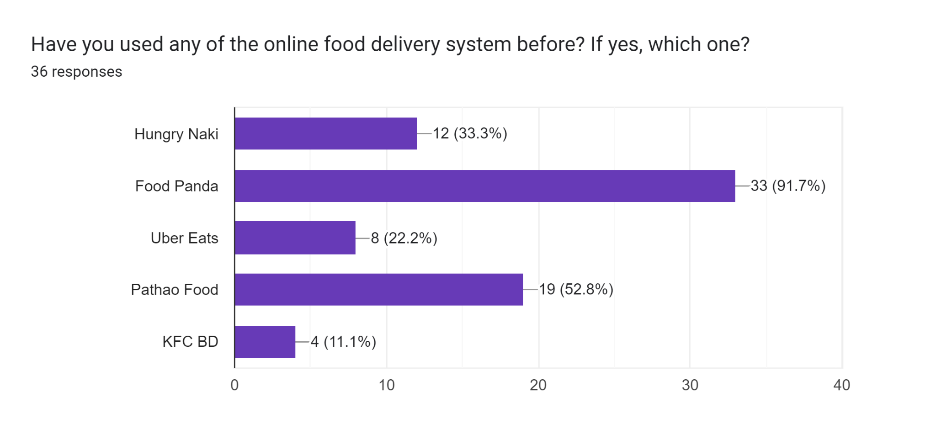
Survey Data Analysis
Have you used any of the online food delivery system before? If yes, which one?
First is Food Panda, then Pathao Food.
Most users use multiple systems.

Slide 6
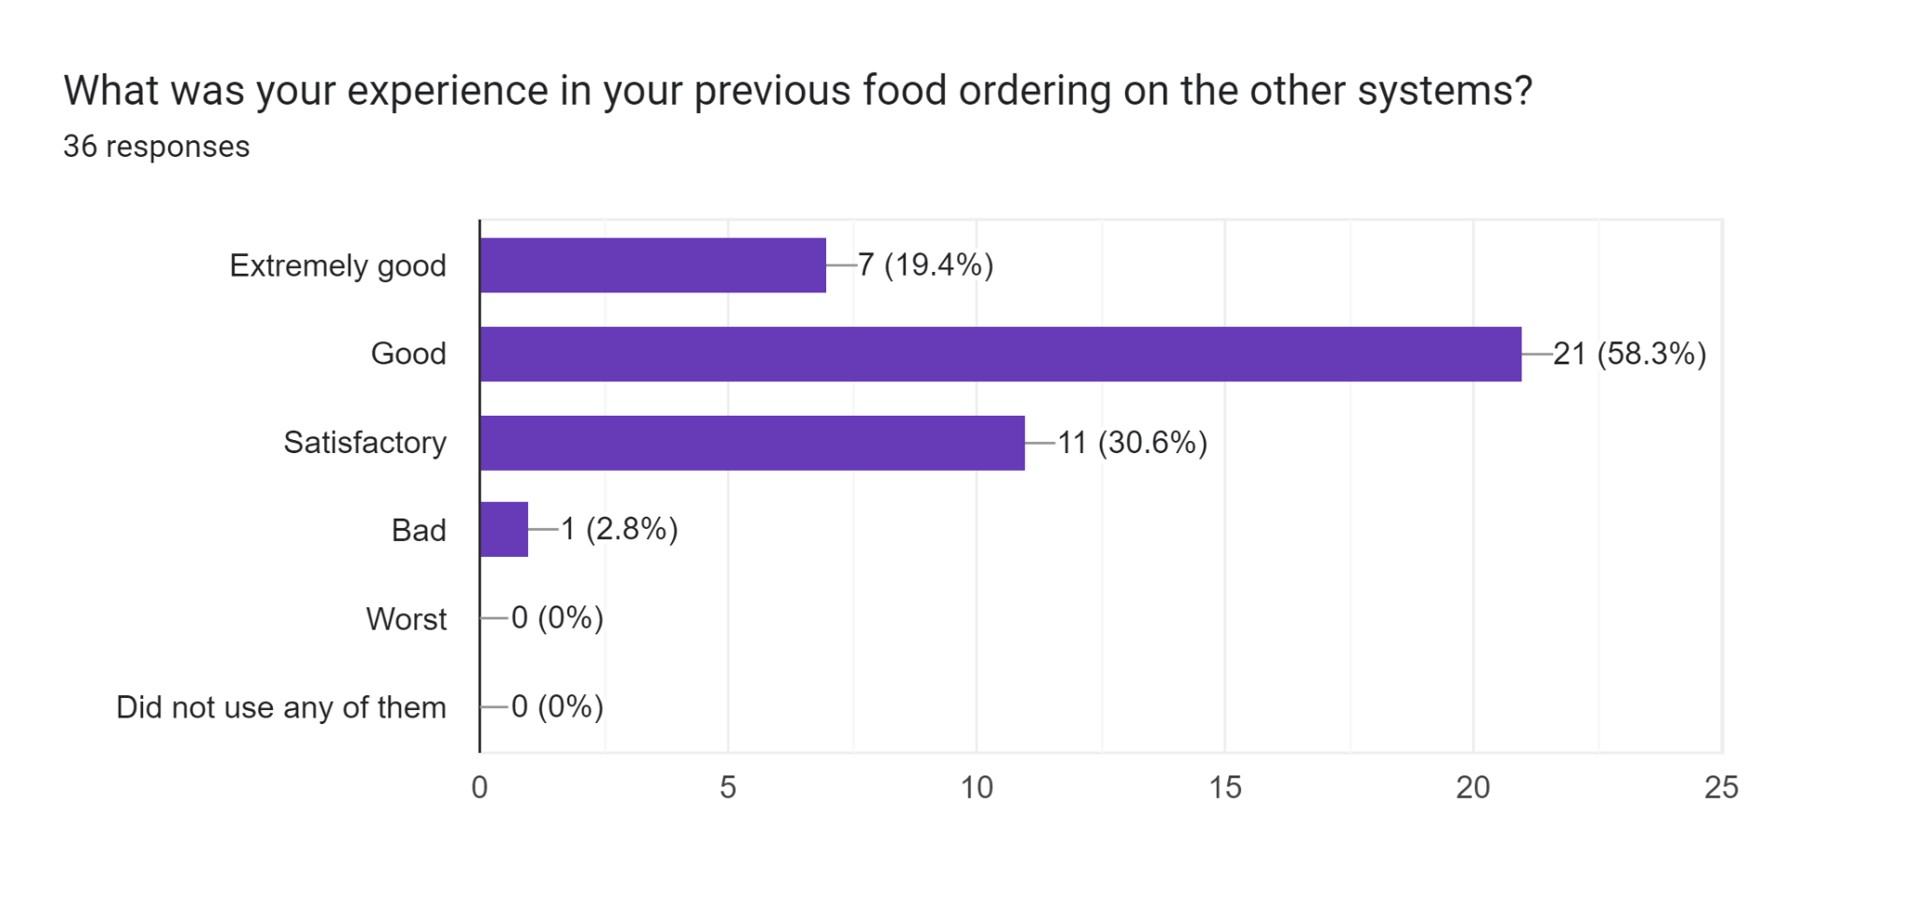
Survey Data Analysis
What was your experience in your previous food ordering on the other systems?
88.9% people’s experience is good & satisfactory.
2.8% people didn’t get good services.

Slide 7
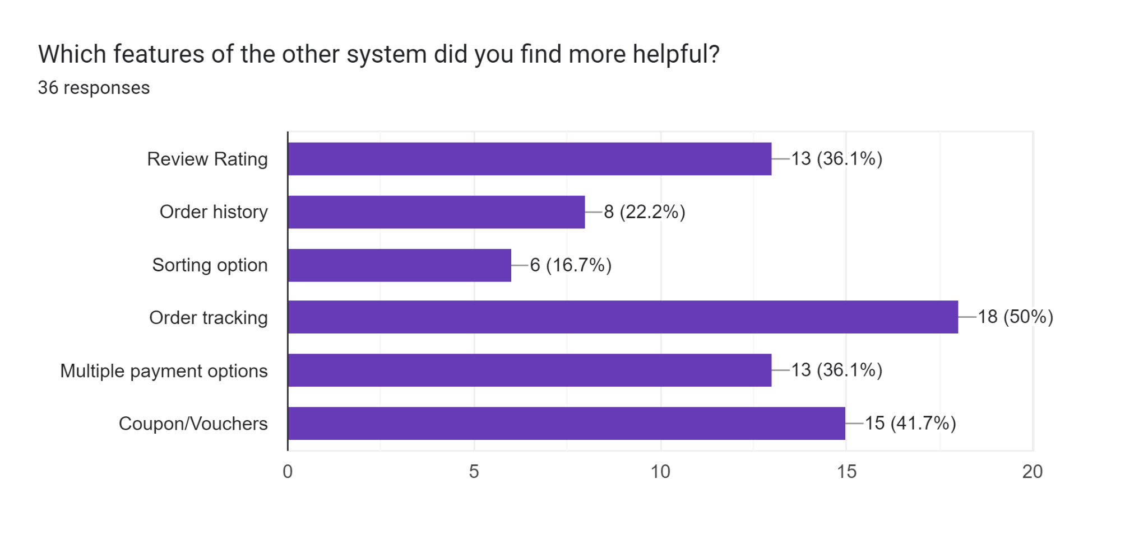
Survey Data Analysis
Which features of the other system did you find more helpful?
Maximum users found order tracking is more useful.

Slide 8
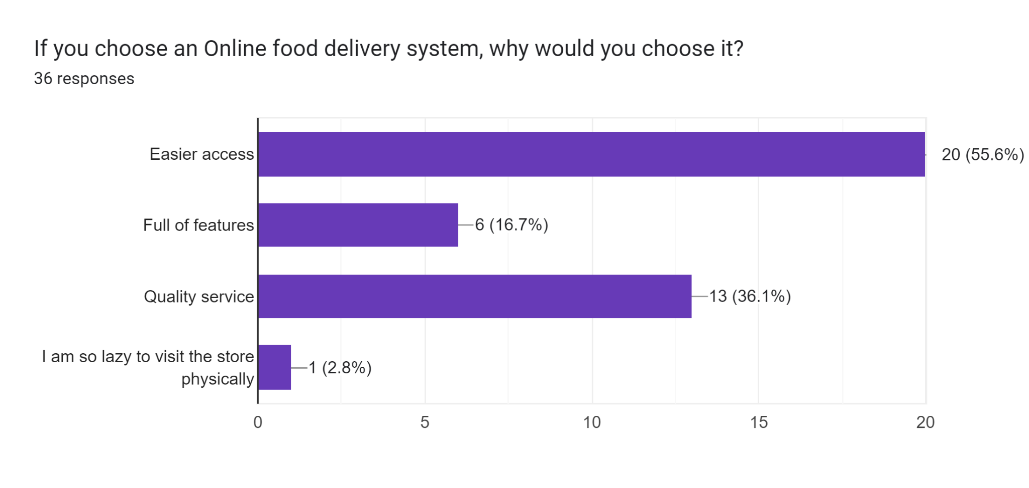
Survey Data Analysis
If you choose an Online food delivery system, why would you choose it?
Chooses a system mainly for Easier access and Quality service.

Slide 9
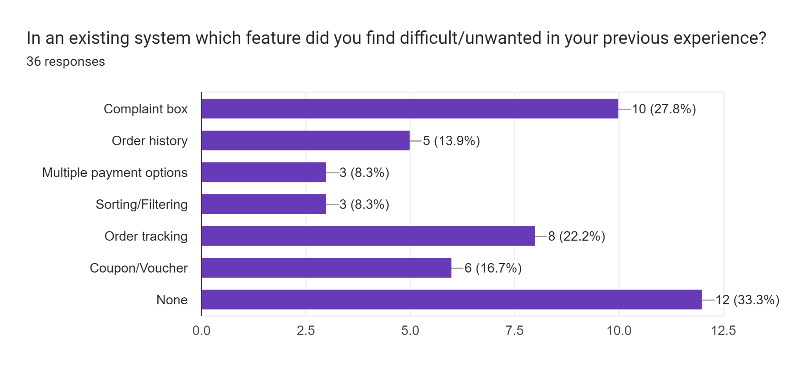
Survey Data Analysis
In existing system which feature did you find difficult/unwanted in your previous experience?
From the chart, it is visible that 33.3 % users feel no feature is difficult and unwanted in the existing system. 27.8% have chosen complaint box as unnecessary.

Slide 10
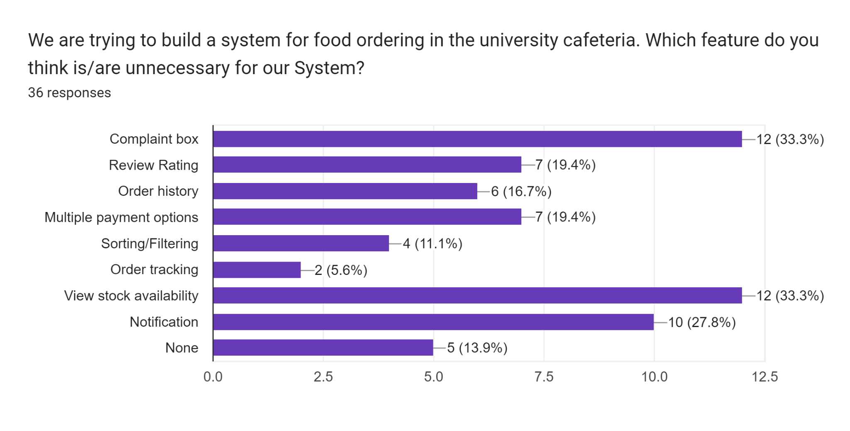
Survey Data Analysis
We are trying to build a system for food ordering in the university cafeteria. Which feature do you think is/are unnecessary for our System?
One third people thinks Complaint box and viewing stock availability are unnecessary.

Slide 11
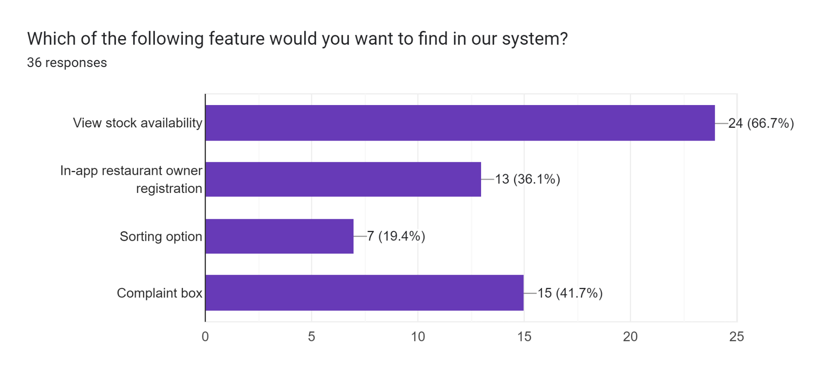
Survey Data Analysis
Which of the following feature would you want to find in our system?
Majority wanted view stock availability (66.7%).
Sorting option was least wanted.

Slide 12
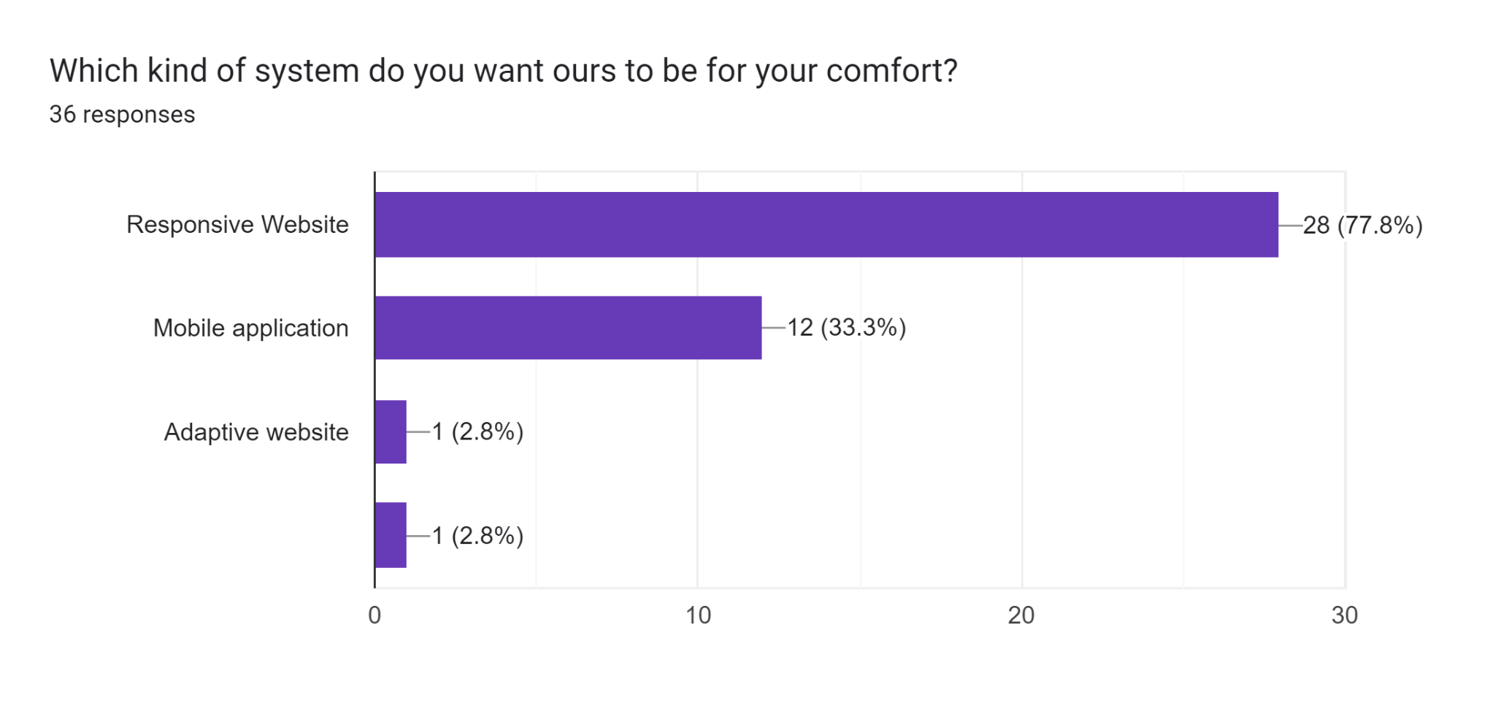
Survey Data Analysis
Which kind of the system you want ours to be for your comfortability?
77.8% positive responded to make it a Responsive website.
We will try our best to implement that.

Slide 13
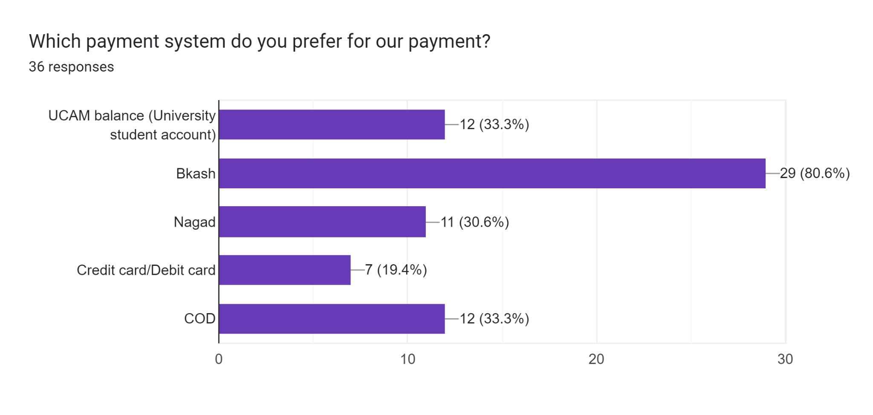
Survey Data Analysis
Which payment system do you prefer for our payment?
Bkash is 80% and UCAM balance and COD is 33.3%.
Credit card least wanted in our system.

Slide 14
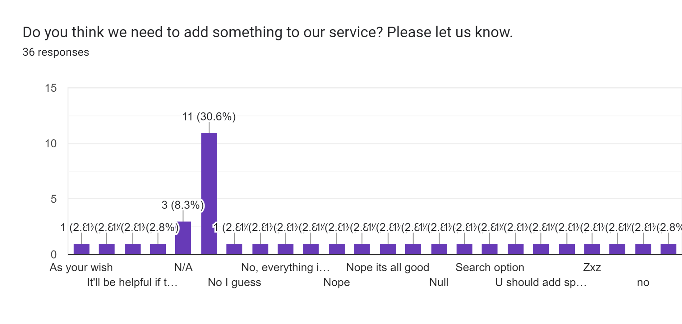
Survey Data Analysis
Do you think we need to add something in our service? Please let us know.
-View crowd condition of cafeteria at a particular moment.
-Discount and offers.
-Although most people seemed satisfied with provided features by us.

Slide 15
Modified Feature List
User sign up login
Search and choose item
Cart
Reg. for homemade food by students with admin approval.
Room delivery for faculty and homemade food.
Payment options (Bkash, Nagad, UCAM and COD)
Review & Rating
Stock availability check
Order history
Complaint box
Admin order monitoring
Notification
Add & Update menu items
Show current crowd status of cafeteria
Sorting option & Tracking features eliminated.

Slide 16
SWOT ANALYSIS
STRENGTH
WEAKNESS
.
> We have an excellent communication between us.
> It’ll provide a convenient way for students/staff to order food from their favourite restaurant without leaving their places.
> Offers fast and efficient delivery service to maintain customer satisfaction.
> The website will offer reviews for customers indicating high levels of customers satisfaction.
> We lack marketing knowledge.
>Currently we do not have Android or IOS developers and security experts in our team.
> Limited ability to control food quality as it has limited control over food quality,, which can result in dissatisfied customers.

Slide 17
SWOT ANALYSIS
OPPORTUNITY
THREATS
>Intense competition as many developers are trying to create similar systems for our cafeteria.
>Negative reviews backlash. Negative reviews from dissatisfied customers lead to a decrease in demand of our system.
>Expansion to other universities. This website can expand to every other institution with canteens
>Partnership with cafeteria and students. This website supports new restaurants and students to register themselves to serve and deliver food.

Slide 18
SWOT ANALYSIS
STRATEGY
As our target audience is very small in number and our work field is only limited to our campus, this might come as an obstacle. But with such enthusiastic team spirit like ours, and a greater motivation to make our campus a better place, we can use this obstacle to our advantage and make life easier for ourselves.
Address weaknesses to improve customer satisfaction by developing better partnerships, investing in technology, and improving communication with restaurants.
Reduce threats by diversifying services, staying up-to-date with regulations, and addressing negative feedback.
Differentiate from competitors by introducing new and unique features.
.
.

Slide 19
THANK YOU !

